Slide 1

Digital Forensics in Environmental Data Integrity Verification
Information Security Fundamentals | Ecological Behaviour and Knowledge Management
Course: Information Security Fundamentals | Chapter: Ecological Behaviour and Knowledge Management | Program: Bachelor of Engineering
DISCOVER · LEARN · EMPOWER
Notes:
Welcome everyone to this lecture on Digital Forensics within our Environmental context. We are exploring how we verify the truth of data in ecological studies. This session is part of our broader chapter on Ecological Behaviour and Knowledge Management. Remember, our motto is Discover, Learn, and Empower.

Slide 2
Course Outcomes
SLIDE 2 / 14
Course Outcome
CO | BT LEVEL | DESCRIPTION
CO1 | BT4 | Recall, analyze and respond on fundamental environmental principles, such as ecological relationships and conservation strategies
CO2 | BT4 | Understand and analyze the interconnections between human activities and environmental impacts across different ecosystems
CO3 | BT4 | Understand and analyze and apply environmental laws and policies to analyse and propose solutions for real-world environmental challenges.
CO4 | BT2 | Students will analyse data from environmental monitoring programs to assess trends and predict future impacts on ecosystems.
CO5 | BT6 | Interpret, elaborate and propose various tools, design and innovative strategies for sustainable development and environmental conservation initiatives in securing the planet.
Chandigarh University
2 / 14
Notes:
Today's lecture directly addresses Course Outcome 4. You will learn to analyze data from environmental monitoring programs to assess trends. This involves using digital forensics to ensure the data is not tampered with. By the end, you will be able to predict future impacts on ecosystems based on verified data.

Slide 3
Learning Objectives
SLIDE 3 / 14
Learning Outcomes
1
Define digital forensics as applied to environmental data integrity verification.
2
Explain the importance of data integrity in ecological monitoring programs.
3
Identify common methods used to verify the authenticity of sensor data.
4
Analyze how knowledge management systems support forensic data analysis.
5
Evaluate the consequences of compromised environmental data on ecosystem predictions.
Chandigarh University
3 / 14
Notes:
By the end of this session, you will be able to define digital forensics in our specific context. We will explain why data integrity is critical for ecological monitoring. You will identify methods to verify sensor data authenticity. We will also analyze how knowledge management systems support this forensic analysis. Finally, you will evaluate the consequences of compromised data on ecosystem predictions.

Slide 4
Lecture
SLIDE 4 / 14
Defining Digital Forensics for Ecology
1
Digital forensics involves the recovery and investigation of material found in digital devices.
2
In ecology, it focuses on verifying the integrity of environmental monitoring data streams.
3
It ensures data has not been altered, deleted, or fabricated by unauthorized parties.
4
This process bridges the gap between raw sensor logs and trustworthy scientific knowledge.
5
Without it, ecological models may be built on false or manipulated premises.
6
The scope includes metadata analysis, log file examination, and hash verification.
7
It transforms raw data into legally and scientifically admissible evidence.
Chandigarh University
4 / 14
Notes:
Digital forensics is not just for cybercrime; it is vital for environmental science. It ensures that the data from our sensors has not been tampered with. Think of it as a digital seal of authenticity for our ecological observations. Without this, our entire understanding of ecosystem trends could be based on lies.

Slide 5
Lecture
SLIDE 5 / 14
The Role of Data Integrity in Ecology
1
Data integrity ensures that information remains accurate and consistent over its lifecycle.
2
Environmental trends rely on long-term data series to detect subtle ecosystem shifts.
3
A single corrupted data point can skew the prediction of future climate impacts.
4
Integrity verification prevents malicious actors from hiding pollution events or falsifying compliance.
5
It builds trust between scientists, regulators, and the public regarding environmental health.
6
Knowledge management systems depend on this integrity to store reliable historical records.
7
Loss of integrity leads to flawed policy decisions and ineffective conservation strategies.
Chandigarh University
5 / 14
Notes:
Data integrity is the backbone of reliable ecological science. If a single data point is corrupted, it can skew the entire prediction of future climate impacts. Imagine trying to predict a flood based on a fake rainfall record. Integrity verification prevents malicious actors from hiding pollution events. It builds trust between scientists and the public regarding environmental health.

Slide 6
Verification Methods
SLIDE 6 / 14
Hashing and Signatures
1
Cryptographic hashing creates a unique digital fingerprint for every data packet.
2
A hash function converts data into a fixed-size string of characters.
3
Any change in the original data results in a completely different hash value.
4
Digital signatures use private keys to sign data, proving the source identity.
5
Verification involves recalculating the hash and comparing it to the stored value.
6
This method detects even the smallest alteration in environmental sensor readings.
7
It is the primary defense against data tampering in automated monitoring networks.
Chandigarh University
6 / 14
Notes:
We use cryptographic hashing to create a unique digital fingerprint for every data packet. If a single bit changes, the hash value changes completely. Digital signatures use private keys to sign data, proving the source identity. This method detects even the smallest alteration in environmental sensor readings. It is the primary defense against data tampering in automated monitoring networks.

Slide 7
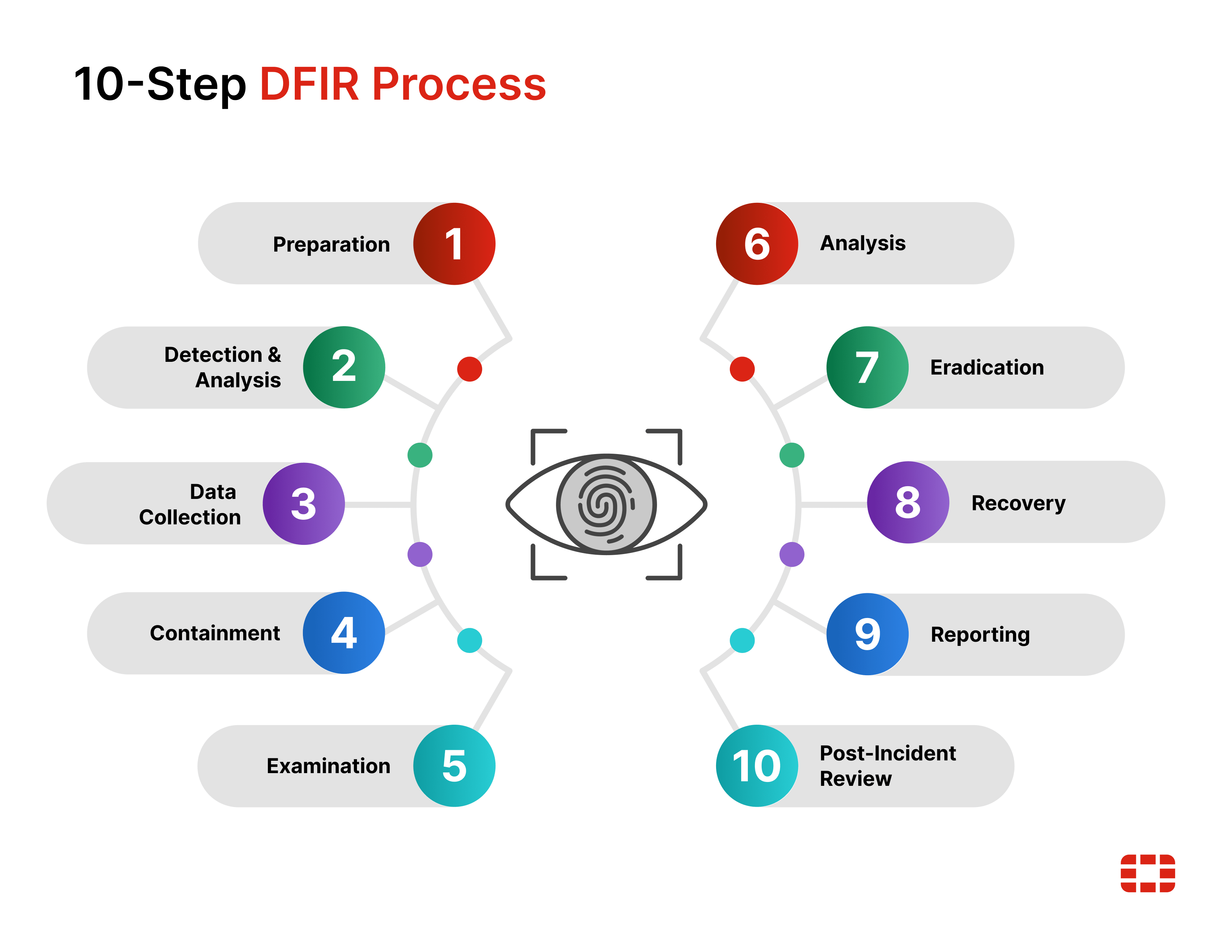
Lecture
SLIDE 7 / 14
Metadata Analysis for Contextual Verification
1
Metadata provides context about the data, such as time, location, and sensor ID.
2
Forensic analysis checks if metadata timestamps align with physical event logs.
3
Inconsistent metadata can indicate data injection or system clock manipulation attacks.
4
Geolocation data must match the physical location of the environmental sensor.
5
Cross-referencing metadata with other sources validates the authenticity of the record.
6
It helps reconstruct the timeline of events during a suspected data breach.
7
Metadata analysis is crucial for understanding the 'who, when, and where' of data.
What is DFIR? How Digital Forensics and Incident Response Works | Fortinet (source: marvel-b1-cdn.bc0a.com)
Chandigarh University
7 / 14
Notes:
Metadata provides context about the data, such as time, location, and sensor ID. Forensic analysis checks if metadata timestamps align with physical event logs. Inconsistent metadata can indicate data injection or system clock manipulation attacks. It helps reconstruct the timeline of events during a suspected data breach. Metadata analysis is crucial for understanding the 'who, when, and where' of data.

Slide 8
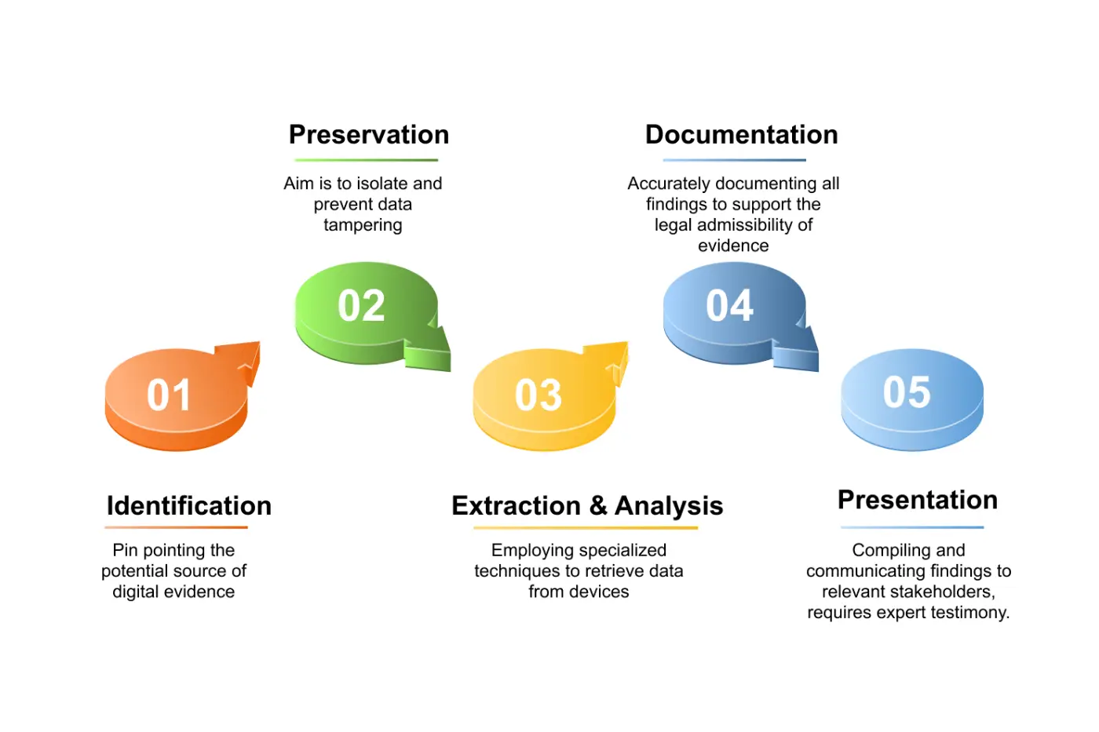
Lecture
SLIDE 8 / 14
Knowledge Management Systems and Forensics
1
Knowledge management systems store and organize environmental data for future analysis.
2
Forensic tools integrate with these systems to audit data access and changes.
3
They maintain an immutable audit trail of who accessed or modified data.
4
This ensures that the knowledge base remains a reliable source of truth.
5
Automated alerts can trigger when suspicious data modifications are detected in real-time.
6
It supports the 'Ecological Behaviour' aspect by preserving the history of changes.
7
Secure storage prevents unauthorized deletion of critical historical environmental records.
Essential Guide to the Digital Forensics Process | Fidelis Security (source: cdn-ilbcohb.nitrocdn.com)
Chandigarh University
8 / 14
Notes:
Knowledge management systems store and organize environmental data for future analysis. Forensic tools integrate with these systems to audit data access and changes. They maintain an immutable audit trail of who accessed or modified data. This ensures that the knowledge base remains a reliable source of truth. It supports the 'Ecological Behaviour' aspect by preserving the history of changes.

Slide 9
Worked Example
SLIDE 9 / 14
Hash Verification Calculation
SCENARIO
A sensor sends a reading of 45.5 ppm for CO2.
STEP 1
Calculate the SHA-256 hash of the original data packet.
STEP 2
Store the hash value: a1b2c3d4e5f6... (hypothetical 64-char string).
STEP 3
Later, a user claims the reading was 46.0 ppm.
STEP 4
Recalculate the hash for 46.0 ppm and compare.
STEP 5
The new hash is completely different, proving tampering occurred.
CONCLUSION
The system flags the data as unverified and rejects it.
Chandigarh University
9 / 14
Notes:
Let's look at a worked example. A sensor sends a reading of 45.5 ppm for CO2. We calculate the SHA-256 hash of the original data packet. Later, a user claims the reading was 46.0 ppm. We recalculate the hash for 46.0 ppm and compare. The new hash is completely different, proving tampering occurred. The system flags the data as unverified and rejects it.

Slide 10
Lecture
SLIDE 10 / 14
Common Pitfalls in Environmental Forensics
1
Relying solely on visual inspection of data plots without cryptographic checks.
2
Ignoring metadata discrepancies that indicate clock synchronization issues.
3
Using weak hashing algorithms that can be easily brute-forced.
4
Failing to secure the private keys used for digital signatures.
5
Overlooking the possibility of sensor hardware malfunction mimicking tampering.
6
Not having a clear chain of custody for digital environmental evidence.
7
Assuming all data from a trusted sensor is automatically authentic.
What is DFIR? How Digital Forensics and Incident Response Works | Fortinet (source: marvel-b1-cdn.bc0a.com)
Chandigarh University
10 / 14
Notes:
There are common pitfalls in environmental forensics that you must avoid. Relying solely on visual inspection of data plots without cryptographic checks is a major error. Ignoring metadata discrepancies that indicate clock synchronization issues can lead to false conclusions. Using weak hashing algorithms that can be easily brute-forced is a security risk. Failing to secure the private keys used for digital signatures compromises the whole system.

Slide 11
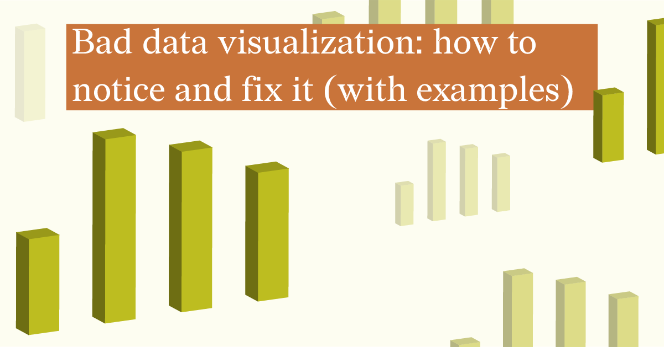
Lecture
SLIDE 11 / 14
Impact of Compromised Data on Predictions
1
False data can lead to incorrect trend analysis of ecosystem health.
2
Predictive models may forecast non-existent pollution events or miss real ones.
3
Resource allocation for conservation may be misdirected based on faulty data.
4
Regulatory bodies might issue unnecessary fines or fail to penalize violators.
5
Public trust in environmental monitoring programs can be severely eroded.
6
Long-term ecological research becomes invalid if the foundational data is suspect.
7
The cost of remediation increases when errors are detected late.
Source: www.datylon.com
Chandigarh University
11 / 14
Notes:
The impact of compromised data on predictions is severe. False data can lead to incorrect trend analysis of ecosystem health. Predictive models may forecast non-existent pollution events or miss real ones. Resource allocation for conservation may be misdirected based on faulty data. Regulatory bodies might issue unnecessary fines or fail to penalize violators. Public trust in environmental monitoring programs can be severely eroded.

Slide 12
Lecture
SLIDE 12 / 14
Best Practices for Data Integrity
1
Implement end-to-end encryption for all environmental data transmission channels.
2
Use strong, industry-standard hashing algorithms like SHA-256 or SHA-3.
3
Regularly audit access logs and verify digital signatures of stored data.
4
Maintain redundant backups of raw data in secure, immutable storage.
5
Train staff on recognizing signs of data tampering and phishing attacks.
6
Establish a clear protocol for reporting and investigating data anomalies.
7
Integrate forensic tools directly into the knowledge management workflow.
Chandigarh University
12 / 14
Notes:
To ensure data integrity, implement end-to-end encryption for all environmental data transmission channels. Use strong, industry-standard hashing algorithms like SHA-256 or SHA-3. Regularly audit access logs and verify digital signatures of stored data. Maintain redundant backups of raw data in secure, immutable storage. Train staff on recognizing signs of data tampering and phishing attacks.

Slide 13
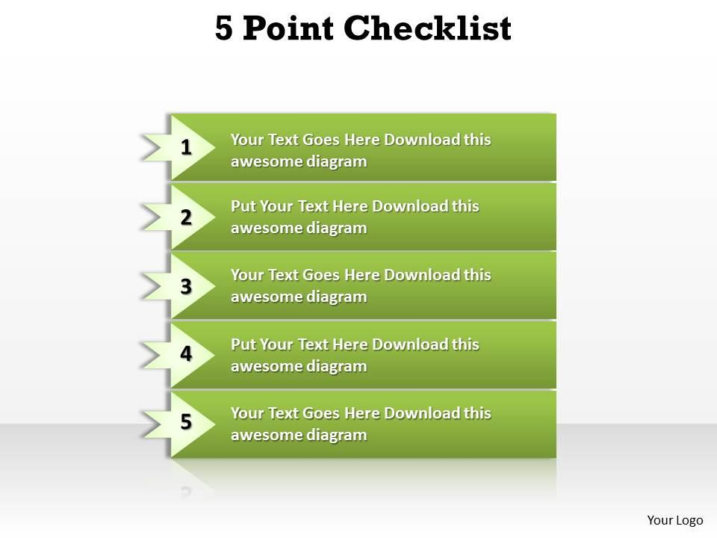
Lecture
SLIDE 13 / 14
Key Takeaways
1
Digital forensics ensures the authenticity and integrity of environmental monitoring data.
2
Cryptographic hashing and digital signatures are essential tools for verification.
3
Metadata analysis helps detect anomalies and reconstruct the timeline of events.
4
Compromised data leads to flawed predictions and ineffective environmental policies.
5
Knowledge management systems must integrate forensic tools for reliable long-term records.
Source: www.slideteam.net
Chandigarh University
13 / 14
Notes:
To summarize, digital forensics ensures the authenticity and integrity of environmental monitoring data. Cryptographic hashing and digital signatures are essential tools for verification. Metadata analysis helps detect anomalies and reconstruct the timeline of events. Compromised data leads to flawed predictions and ineffective environmental policies. Knowledge management systems must integrate forensic tools for reliable long-term records.

Slide 14
Lecture
SLIDE 14 / 14
References
ENVIRONMENTAL STUDIES
From Crisis to Cure — R. Rajagopalan
• Environmental Science and Engineering — Benny Joseph
• Environmental Studies — R.C. Sharma and D. Gurbir Sangha
• Introduction to Environmental Science — Anjaneyulu, Y.
• Environmental Pollution Control Engineering — C.S. Rao
• Textbook of Environmental Studies for undergraduate courses — E. Bharucha
• Environmental Science — S.C. Santra
Chandigarh University
14 / 14
Notes:
These are the reference books for this lecture. They provide the foundational knowledge for environmental science and engineering. Please refer to these texts for further reading on ecological behavior and data management. Thank you for your attention, and I am now open to your questions.

